Slide 1
Hotel Rating Classification

Slide 2
Business Problem:
The major objective is what are the attributes that travelers are considering while selecting a hotel. With this manager can understand which elements of their hotel influence more in forming a positive review or improves hotel brand image.

Slide 3
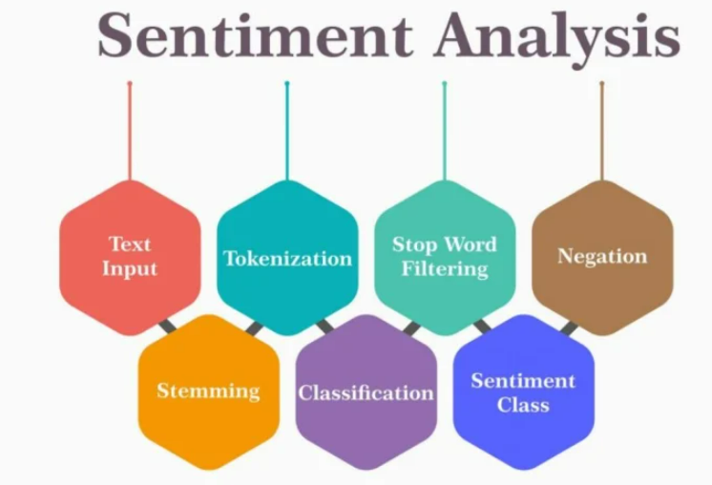
Project Architecture / Project Flow

Slide 4
The Dataset name is Hotel.xlsx.
It consists of two columns.
There are two Columns :
1.Reviews
2. Ratings.
Ratings are given between 1 to 5
No null values are present.
No duplicate values are presents

Slide 5
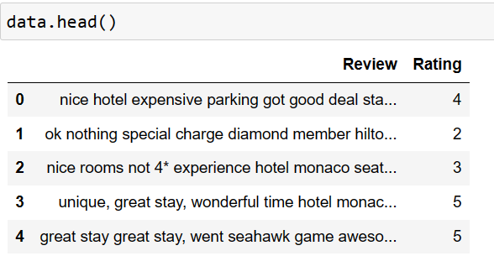
Exploratory Data Analysis (EDA) and
Feature Engineering
This dataset includes revies given by the customers about the hotel and the corresponding rating given by them.
There are 2 features “Review” and “Rating”.

Slide 6
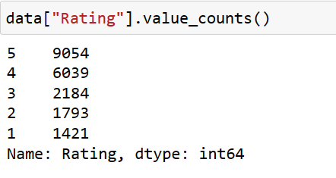
Exploratory Data Analysis (EDA)
The Value Counts of Rating are as below:

Slide 7
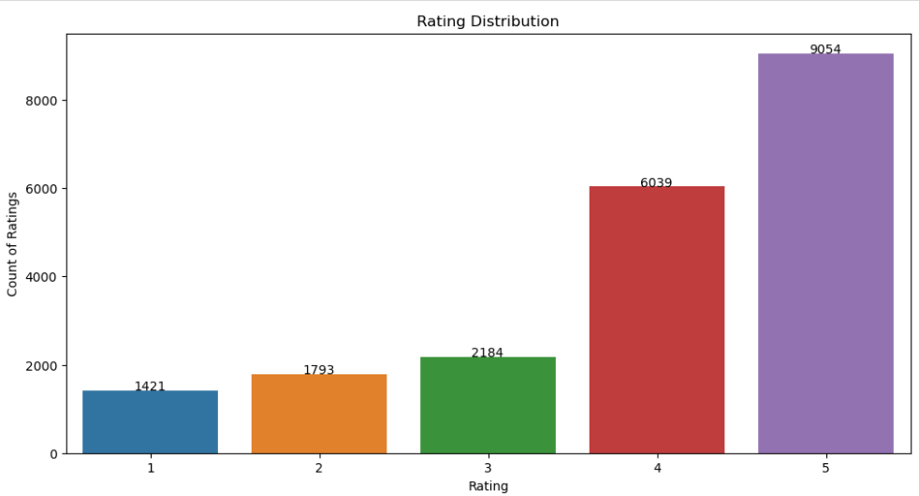
EDA
Data Visualization
From the above we can see that the data is imbalanced

Slide 8
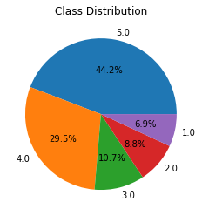

Slide 9
Data Preprocessing
Removing URL’s from the data set.
Removing punctuation.
Removing Stop Words.
Removing Numerical Data.

Slide 10
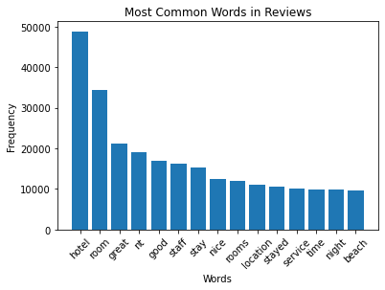
Most common words

Slide 11
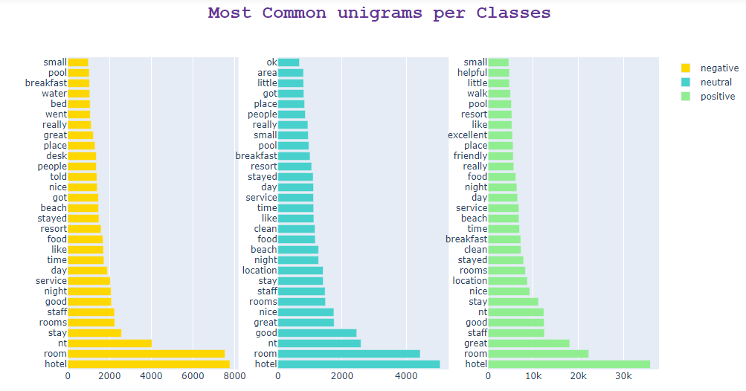
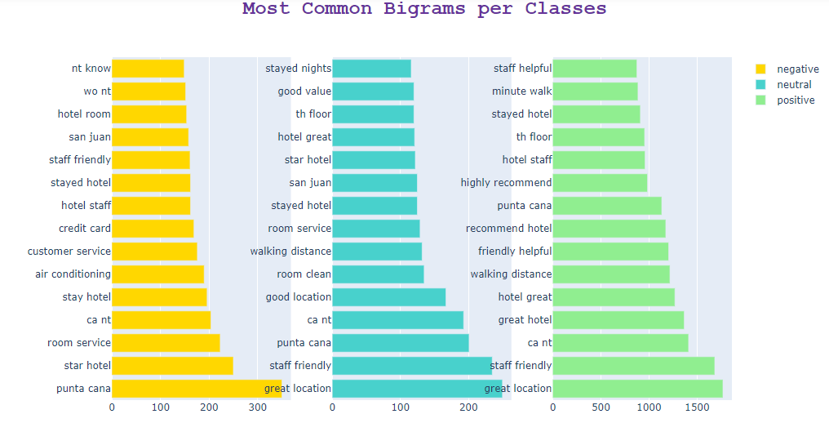
Most common ngrams

Slide 12
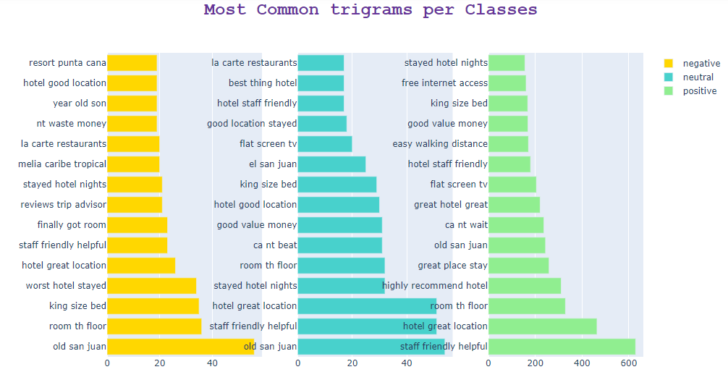

Slide 13
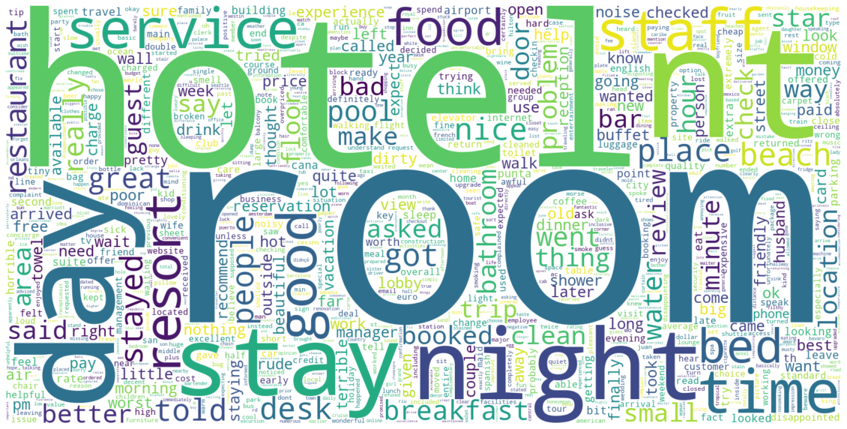
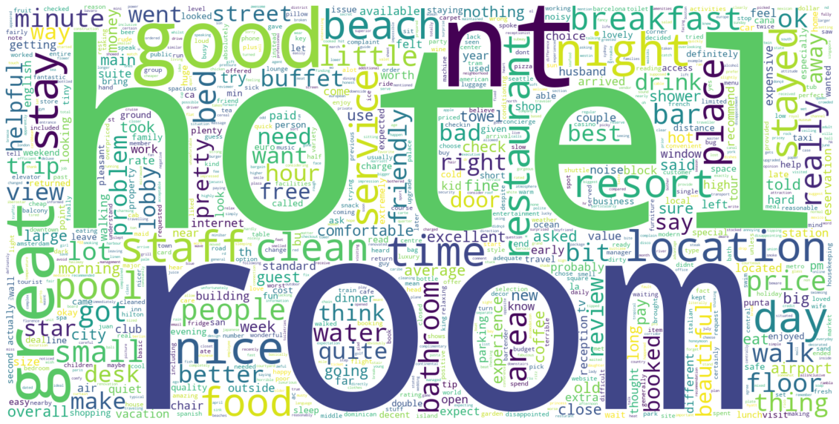
Word Cloud
Negative Rating
Neutral Rating

Slide 14
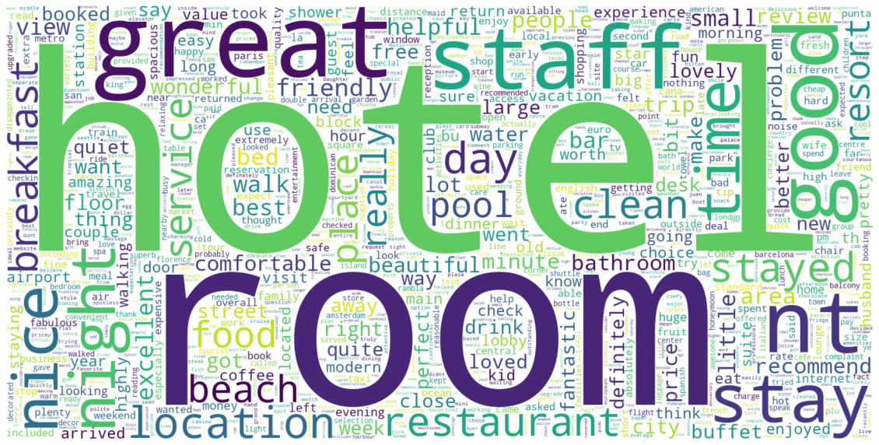
Word Cloud Positive Rating

Slide 15
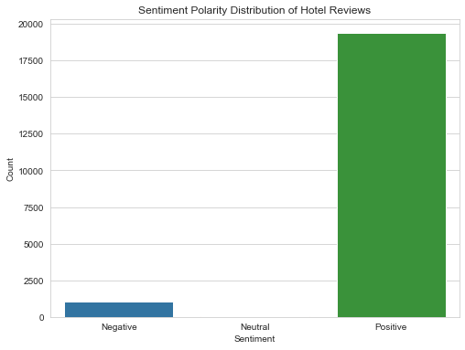
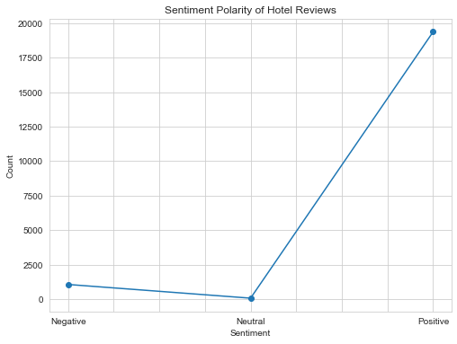
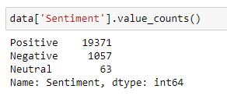
Sentimental Analysis with Vader

Slide 16
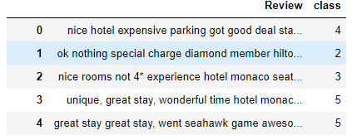
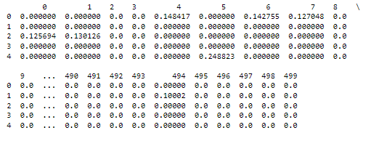
Vectorization of the Input Data
TF-IDF Vectorizer: Converts text data into numerical vectors, emphasizing rare words' importance.
Usage: Commonly used in text analysis, information retrieval, and machine learning for feature extraction and text similarity measurement.
Process: Assigns a score to each word in a document based on its frequency in the document (TF) and rarity across documents (IDF).
Review Data
Vectorized Data

Slide 17
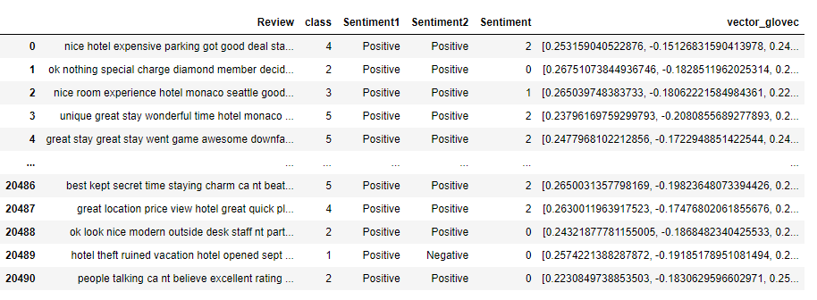
Word Embedding
GloVe(Global Vectors): One key advantage of using GloVe embeddings over TF-IDF representations is that GloVe captures semantic meaning and word relationships in a continuous vector space.
We are using “glove-twitter-200” pre-trained model).
Review Data
Word Embedding

Slide 18
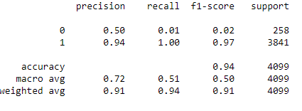
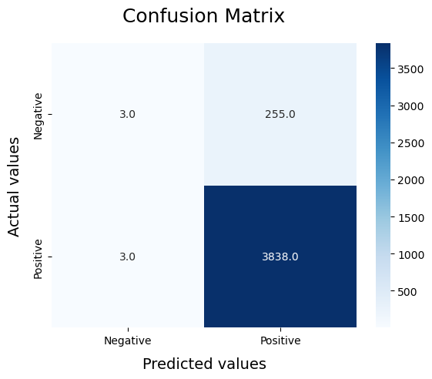
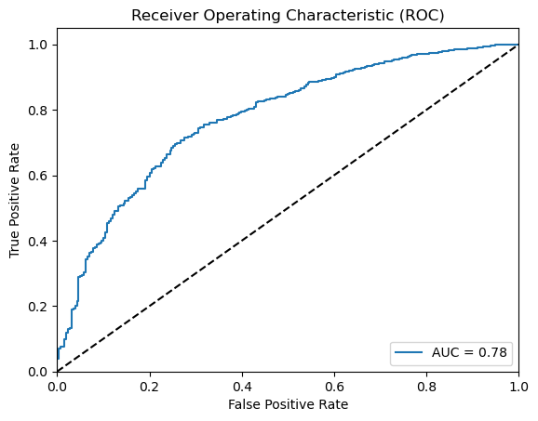
Model Building – Logistic Regression
Classification Report
Confusion Matrix
ROC-AUC Curve

Slide 19
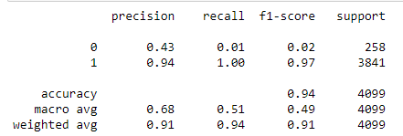

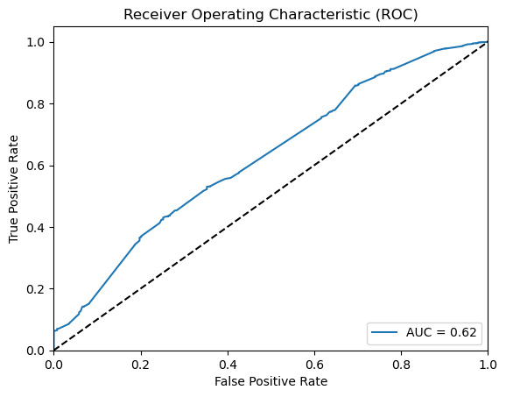
Model Building – Bernoulli Naïve Bayes
Classification Report
Confusion Matrix
ROC-AUC Curve

Slide 20
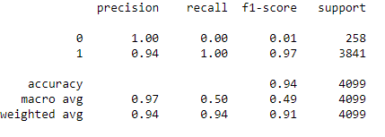
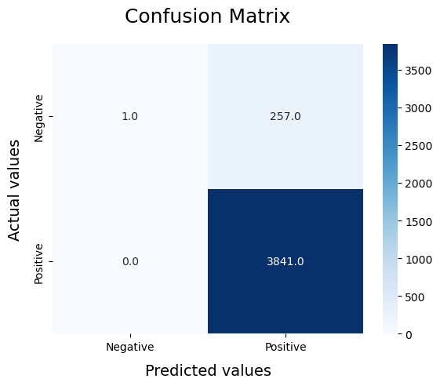
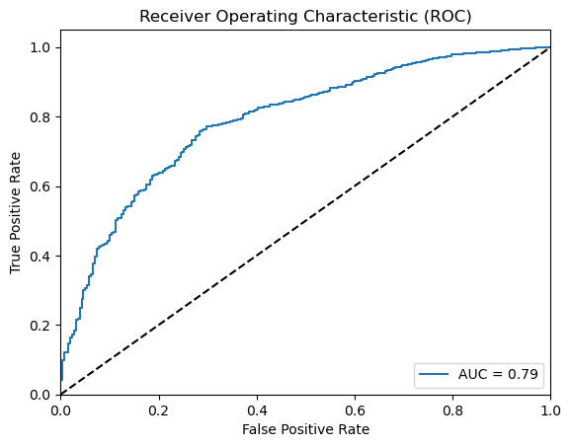
Model Building – Linear Support Vector Classifier
Classification Report
Confusion Matrix
ROC-AUC Curve

Slide 21
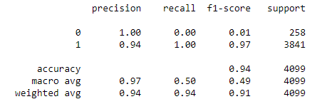
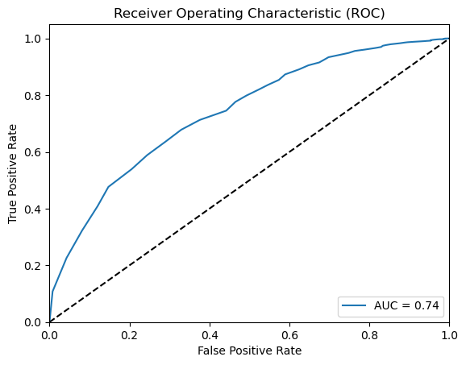
Model Building – Random Forest Classifier
Classification Report
Confusion Matrix
ROC-AUC Curve

Slide 22
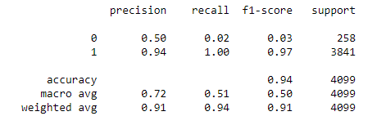

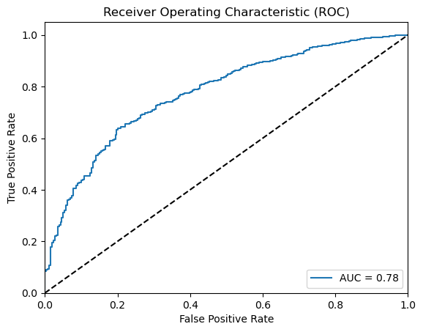
Model Building – XGBoost Classifier
Classification Report
Confusion Matrix
ROC-AUC Curve

Slide 23
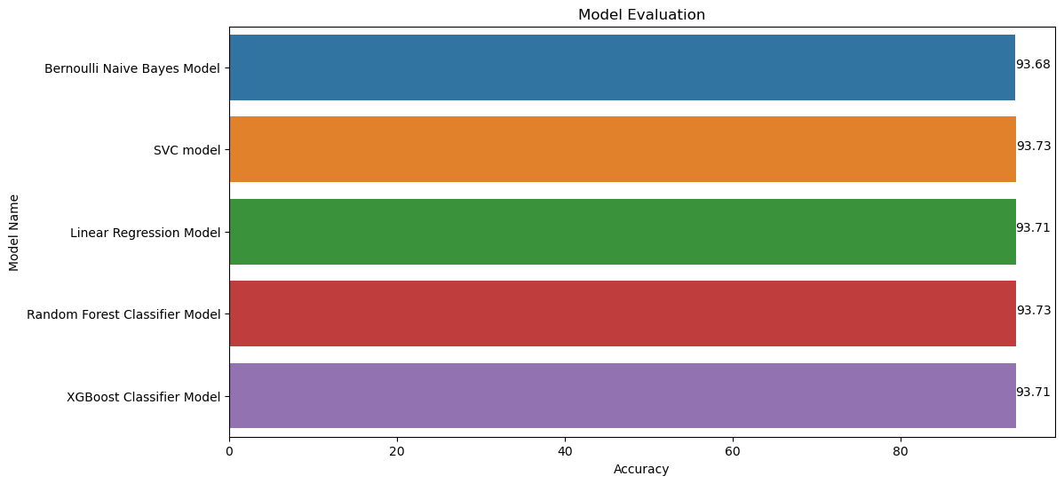
Model Evaluation
Accuracies v/s Model Names
From the above graph , We see that Random Forest Classifier has the best Score

Slide 24
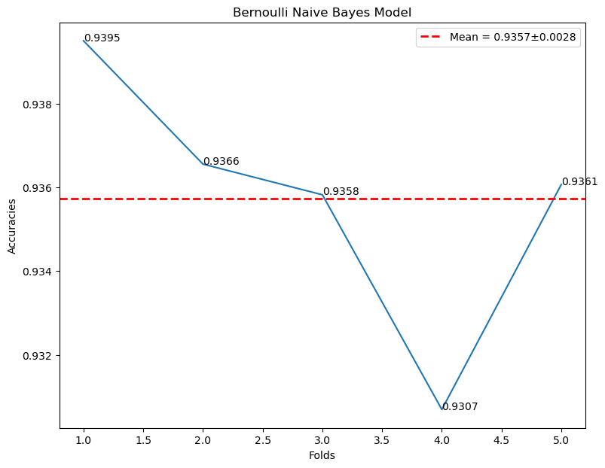
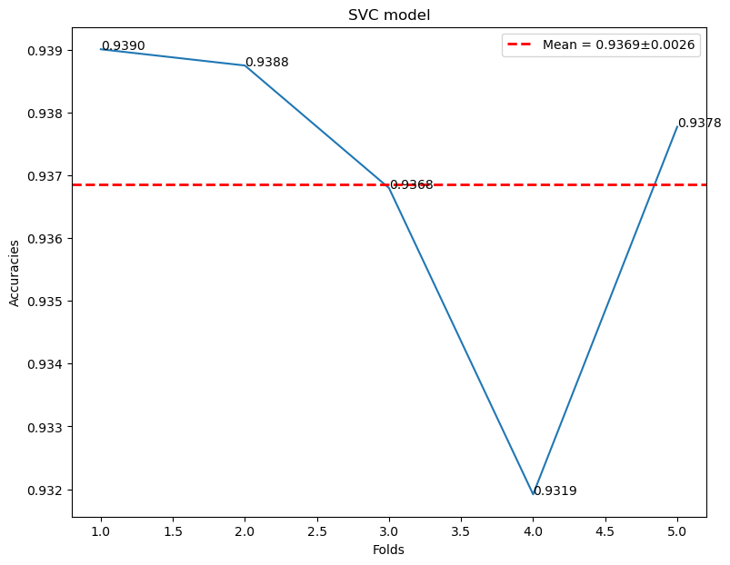
Model Evaluation using K-Fold Cross Validation
Accuracies v/s Folds

Slide 25
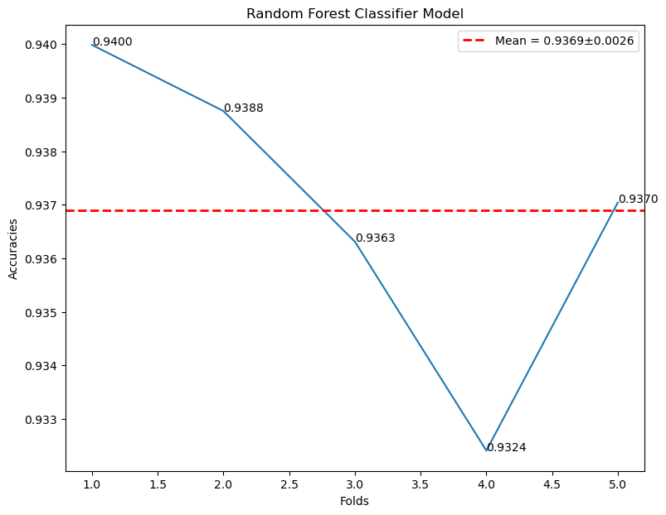
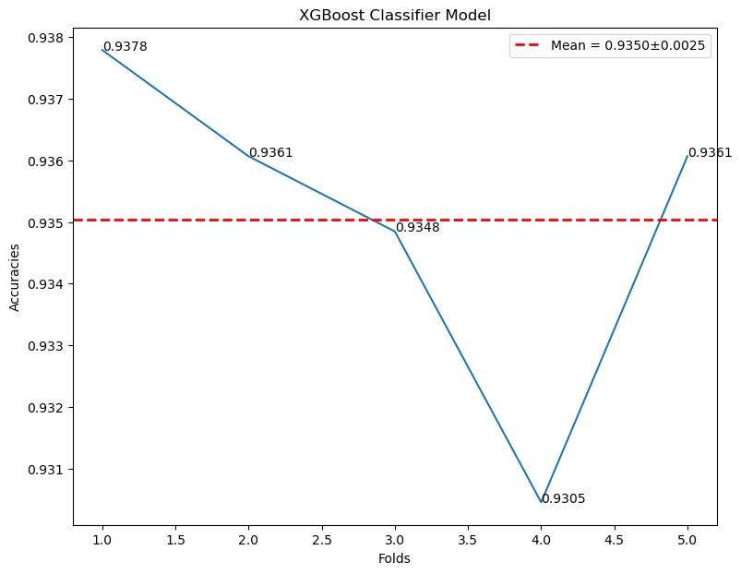
Model Evaluation using K-Fold Cross Validation
Accuracies v/s Folds
From the above graph , we can see that model are not showing any sign of Overfitting or Underfitting as the deviation from each fold is very less

Slide 26
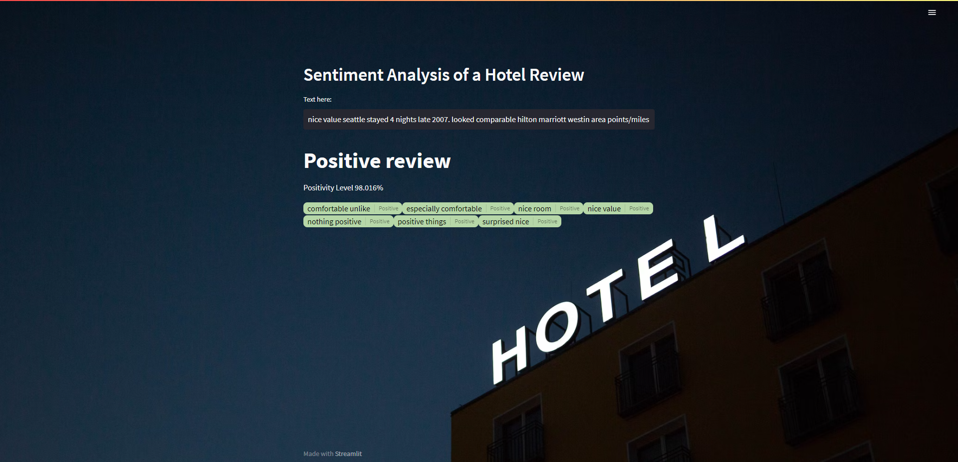
Model Deployment using Streamlit
https://hotelreviewsentimentanalysis-newvfed8sv2pkyed4xeoob.streamlit.app/
Positive Reviews
From the above results, the web app predicts if the review is a “Positive” or “Negative” review, also highlights “Positive attributes” from the review.

Slide 27
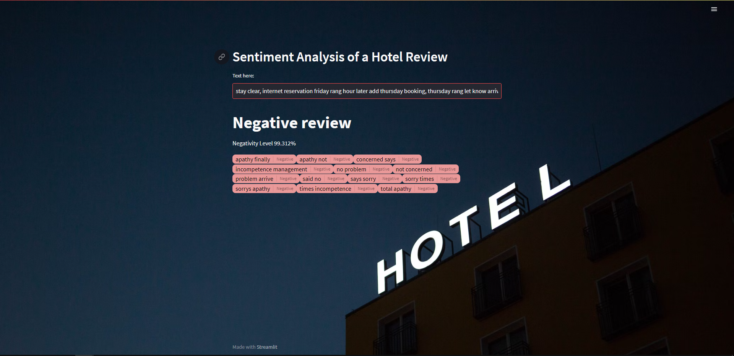
Model Deployment using Streamlit
Negative Reviews
From the above results, the web app predicts if the review is a “Positive” or “Negative” review, also highlights “Negative attributes” from the review.

Slide 28
Challenges faced?
Poor F1-Scores
The F1 score is a commonly used metric for evaluating the performance of classification models, particularly when the dataset is imbalanced.
It takes into account both precision and recall, providing a balanced measure of a model's accuracy.
Problem Solved Using n-grams and Word-embedding
Removing Redundant words from the reviews.
Using TF-IDF Vectorizer for unigram , bigram and Trigram together.
Sparse Matrix/Vectors using TF-IDF Vectorizer
A sparse matrix is a matrix that contains mostly zero values
Problem Solved
Using Glovec (dense vectors) to Capture the Semantics of words(Meanings)

Slide 29
Thank you

